Slide 1
Beer Analytics
Sabrina Purvis
Senthil Kumar
Akbar Thobani
Presenter:

Slide 2

Problem Statement
Budweiser would like to investigate the difference with respect to IBU and ABV between IPAs (India Pale Ales) and other types of Ale (any beer with “Ale” in its name other than IPA)
Is there an apparent relationship between the bitterness of the beer and its alcoholic content?
Notes:
Summarize and change the format to Anz format

Slide 3

Our Approach
Leveraging modern data science techniques and tools, our data scientist performed EDA (Exploratory Data Analysis).
We evaluated transformed available historical data, removed anomalies and applied KNN (near neighbor) classification techniques
We further plotted our findings using easy to interpret visualization

Slide 4

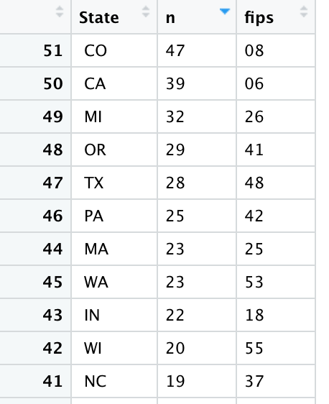
In order to conduct EDA, we carefully evaluate and answered following questions
Q1) How many breweries are present in each state?
Top 10 states has most breweries with CO (Colorado) leading the pack

Slide 5
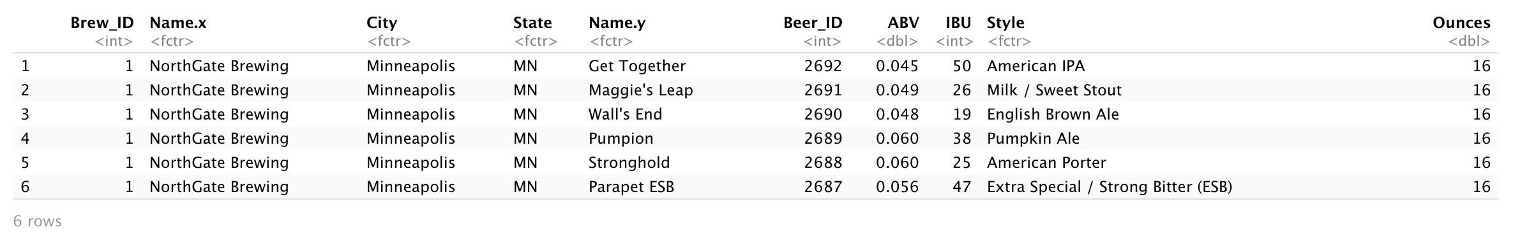
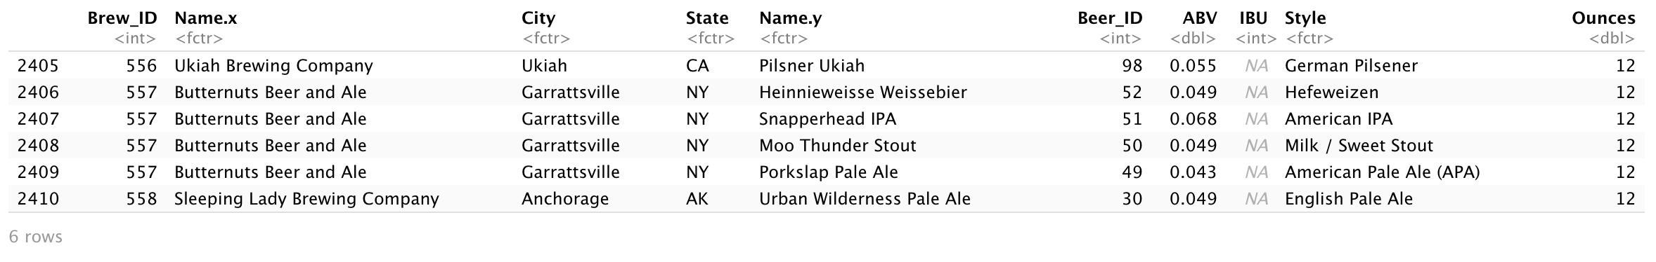
In order to conduct EDA, we carefully evaluate and answered following questions
Q2) Merge beer data with the breweries data. Print the first 6 observations and the last six observations to check the merged file.
Top 6 Breweries and Beer
Bottom 6 Breweries and Beer

Slide 6
In order to conduct EDA, we carefully evaluate and answered following questions
3) Address the missing values in each column.
4) Compute the median alcohol content and international bitterness unit for each state. Plot a bar chart to compare.

Slide 7
In order to conduct EDA, we carefully evaluate and answered following questions
6. Comment on the summary statistics and distribution of the ABV variable.
7. Is there an apparent relationship between the bitterness of the beer and its alcoholic content? Draw a scatter plot. Make your best judgment of a relationship and EXPLAIN your answer.
ABV (Alcohol by volume) has a positive co-relationship with IBU (Beer bitterness index)

Slide 8
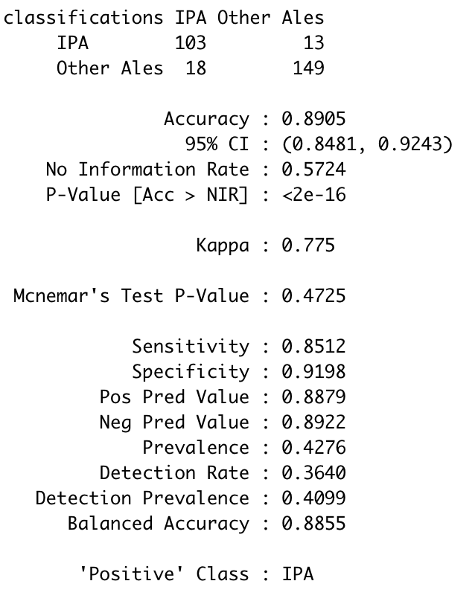
In order to conduct EDA, we carefully evaluate and answered following questions
Q8) Budweiser would also like to investigate the difference with respect to IBU and ABV between IPAs (India Pale Ales) and other types of Ale (any beer with “Ale” in its name other than IPA). You decide to use KNN classification to investigate this relationship. Provide statistical evidence one way or the other. You can of course assume your audience is comfortable with percentages.
Analysis using KNN classification model provided 89% accuracy, it also suggest ~K=5 provides best Mean Accuracy

Slide 9
Summarized Insights

Slide 10

Thank You

